Slide 1

Large Consulting Firm – Return to Office Tracking

Slide 2

Innova Squad (Team Members):
S No | First Name | Last Name | Email | Team
1 | Manomita | Das |  | 9
2 | Maria | Vincent
3 | Md | Irfan
4 | Menden | Arpitha
5 | Monika | MonikaAS
6 | Mouli | Roy
7 | N | SVVVNPavaniBalla
8 | Naveen | Kumar
9 | Neha | Bhattacharya
10 | Nilam | Karande

Slide 3
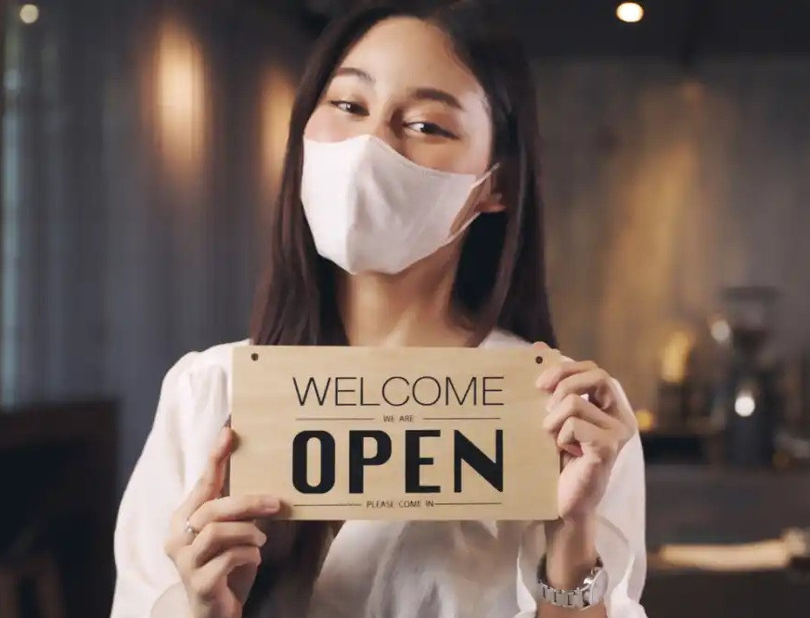
Problem Statement
A company (Hi FIVE Consulting is implementing ServiceNow Application to track return to office for its post COVID set up.
The firm requires the application to track employees who are interested to return to office in a phased manner by triggering survey, initiating requests for interested resource and capture their vaccinations certificates and key medical records and report to management on monthly basis.

Slide 4




Idea of solution
Vaccine certificate upload,
Medical certificate Upload
You are ready to
return to the office
Interested to return office?
Joining Date Generation

Slide 5
Groups
Employee
Document Approval
HR
Management

Slide 6

Branding
Main logo of application
Page header caption
Service Portal Logo

Slide 7

Return To Office Form
Service portal form is created for better user friendly interface,
Trigger notification is also created so that user gets form link.

Slide 8

Tracking task Form
Whenever stage of the return to office form is changing tracking task is created which is need to be completed to get return to office date.

Slide 9

Email Notification
For the tracking task is assigned to group will get a email notification to complete the task.

Slide 10
Flow Designer

Slide 11
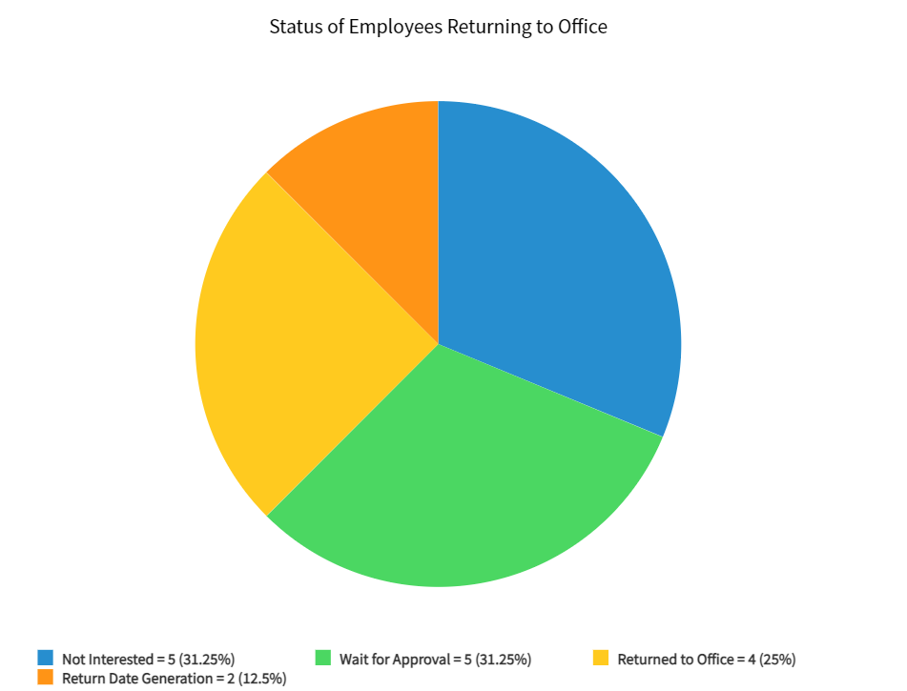
Report
Monthly report will sent to the management team about the stages of employee return to office form.

Slide 12
ACKNOWLEDGEMENT
We would like to express our sincere gratitude to TCS and SERVICE NOW organizations for supporting us throughout our journey . First, we wish to express our sincere
gratitude to our mentor for his enthusiasm, patience, insightful comments, helpful information, practical advice and unceasing ideas that have helped
us tremendously at all times. There immense knowledge, profound experience and professional expertise has helped us a lot to complete this project on large consulting firm return to office tracking
At last but not in least we would like to thank all who helped and motivated us.

Slide 13


